Slide 1

Chronic Hepatitis C Virus Infection
Epidemiological and clinic-evolutional aspects
Dr. Lazăr Ştefan
Assistant professor UMF Carol Davila

Slide 2
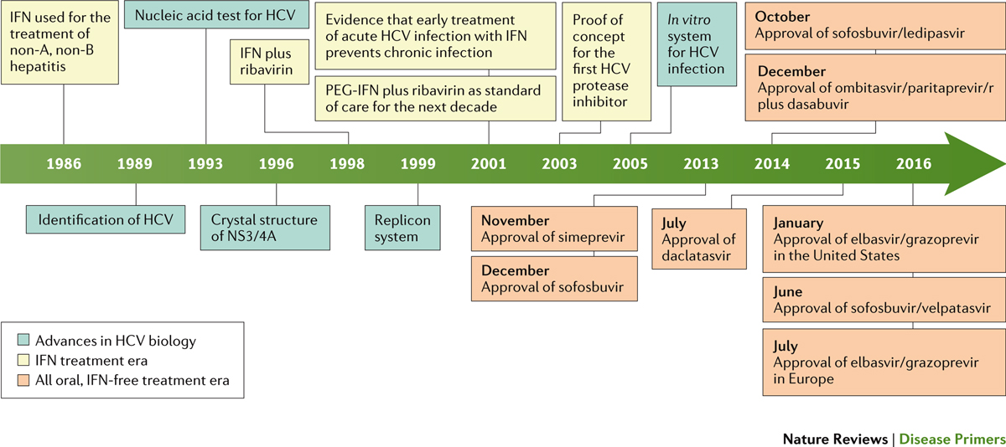
Important moments in HCV research and management
Manns, M. P. et al. (2017) Hepatitis C virus infection
Nat. Rev. Dis. Primers doi:10.1038/nrdp.2017.6

Slide 3
Global data
184 million people with Ac Anti HCV present (GBD2010)
Seroprevalence: 2.8% of the world population in 2005
60-85% infected (HCV RNA present)
~ 2.2 million people with HCV worldwide are currently in prisons
In Romania ~ 600,000 HCV infected persons

Slide 4
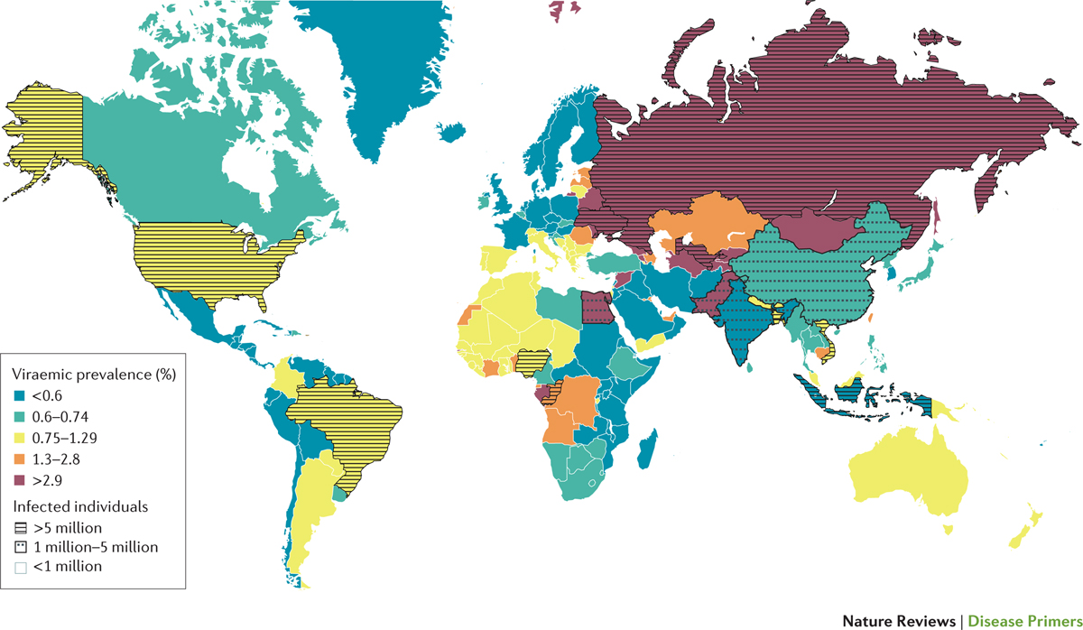
Prevalence of HCV infection
Manns, M. P. et al. (2017) Hepatitis C virus infection
Nat. Rev. Dis. Primers doi:10.1038/nrdp.2017.6

Slide 5
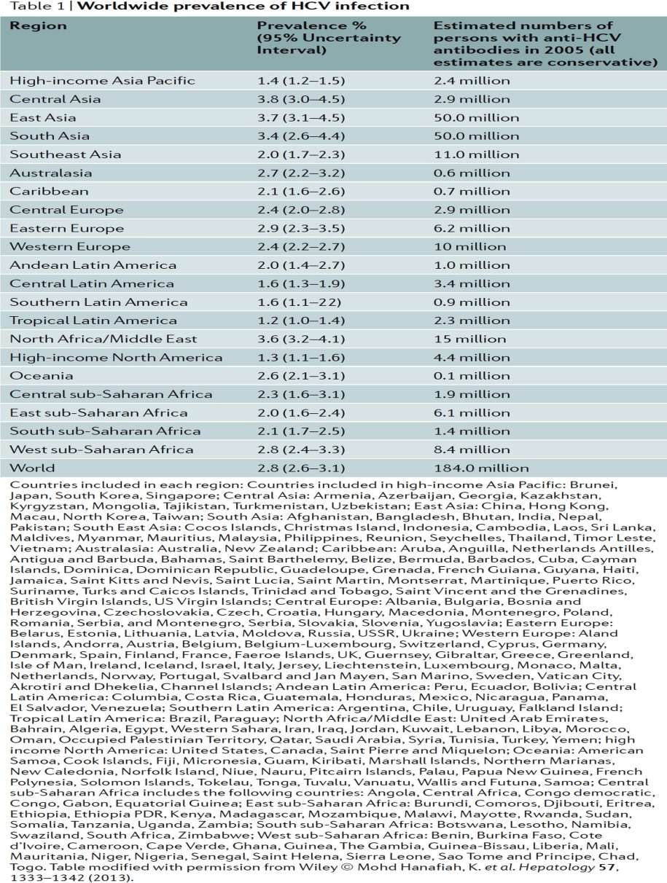
The global prevalence of HCV infection
Thrift, A. P. et al. (2016) Global epidemiology and burden of HCV infection and HCV-related disease
Nat. Rev. Gastroenterol. Hepatol. doi:10.1038/nrgastro.2016.176

Slide 6
Global evolution of infection
122 million in1990 184 million in 2005
50% of people infected: China, Pakistan, India, Egypt and Russia
Decline in prevalence in Sub-Saharan Africa, N. Africa, Middle East
Increases in prevalence in East Asia, Europe and the Western Pacific

Slide 7
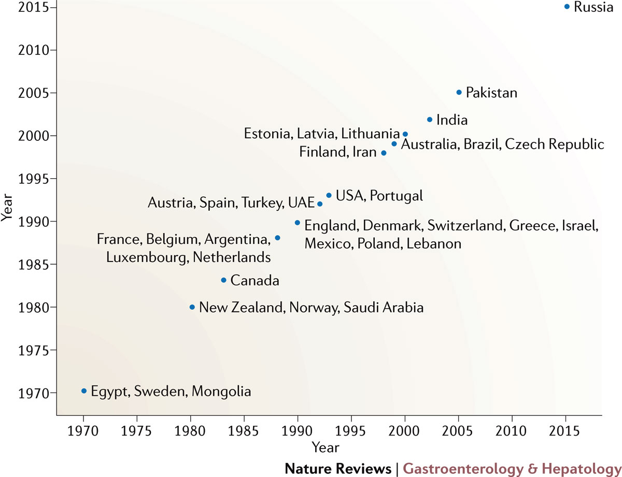
Year of peak incidence in various countries
Thrift, A. P. et al. (2016) Global epidemiology and burden of HCV infection and HCV-related disease
Nat. Rev. Gastroenterol. Hepatol. doi:10.1038/nrgastro.2016.176
Notes:
Figure 3 | Year of peak incidence in HCV infection across sample countries. Data adapted from several sources: Refs 15,16,17.

Slide 8
Age and gender distribution of HCV
Peak prevalence at 55-64 years in most regions (iatrogen model)
Western Sub-Saharan Africa a first peak at 15-19 years, East Asia at 20-24 years
USA, Western Europe: 2 prevalence peaks
In most countries, HCV prevalence is higher in males than in women (behaviors at risk)
France, Germany, Turkey increased prevalence in women (predominantly nosocomial transmission)

Slide 9
Current trend in evolution of disease
Decline of global incidence (except Russia)
Trends in maintaining increased incidence due to IDU (70% new cases in the US), sex workers, MSM
The apparent decrease in iatrogenic infection in countries with a stable medical system
WHO: 2 million infections / year through unsafe injections
Nosocomial infections: an important source of infection, especially in countries with high prevalence (Egypt, Pakistan and Eastern Europe)

Slide 10
Prevention of HCV transmission and screening
Prior to HCV identification: transfusions of blood or blood products - a major way of transmitting HCV
In approximately 40 countries, blood products are not tested; in many countries: random testing
There are no official WHO recommendations on HCV population screening
Expert recommendations: people at-risk and baby-boomers (73% of HCV infected in the US)

Slide 11
Screening recomandations
IDUs (former or current)
Recipients of coagulation factors, transfusions, transplantation before 1990
Recipients of transfusions from a positively tested donor for HCV
Hemodialysis with long-term abnormal levels of ALT
People with invasive medical procedures in the past
People with HIV infection
Health and public safety workers
Children born of positive HCV women
People with multiple sexual partners
Screening of the cohort (USA) those born between 1945 and 1965

Slide 12
Current genotypes
6 known genotypes (30-35% nucleotide variability)
Importance of identification: different treatment behavior
Genotype 1: 83.4 million cases (46.2% of total) US, Europe, Japan, predominantly in 85 countries
Genotype 3: 54.3 million cases (30.1%) South Asia, serious complications, increased mortality
Genotype 4: Central Africa, Middle East
Genotype 5: South Africa
Genotype 6: very rare (predominantly in Laos)

Slide 13
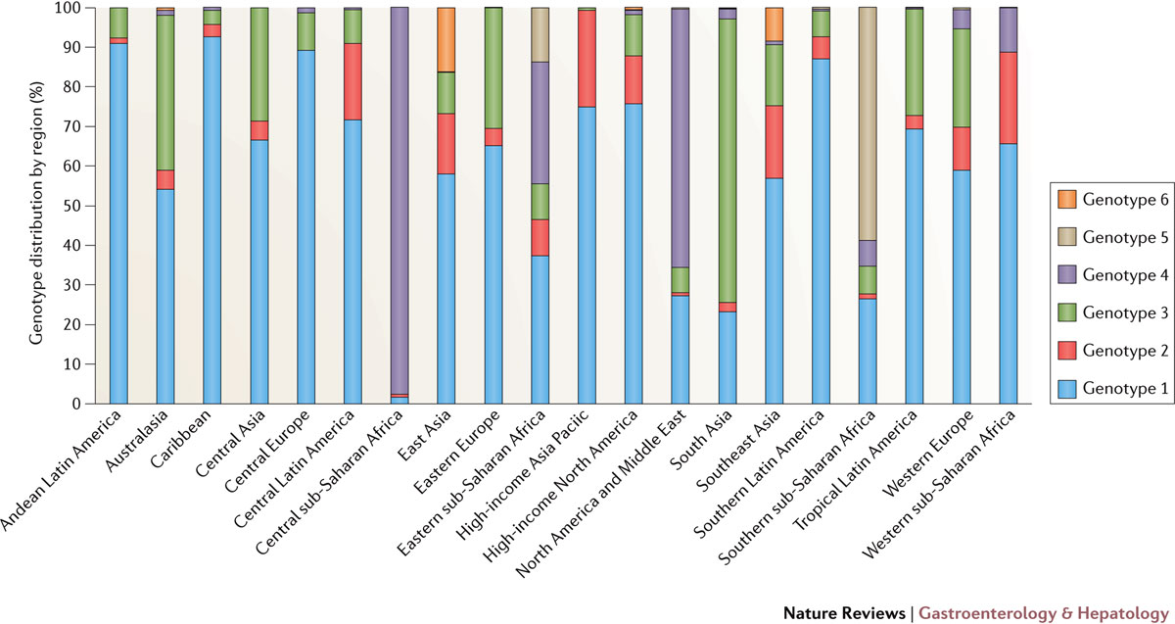
Regional estimation of HCV genotypes
Thrift, A. P. et al. (2016) Global epidemiology and burden of HCV infection and HCV-related disease
Nat. Rev. Gastroenterol. Hepatol. doi:10.1038/nrgastro.2016.176
Notes:
Figure 2 | Regional estimates of HCV seroprevalence attributable to each HCV genotype. Genotypes 1 and 3 account for the majority of HCV cases worldwide. However, the frequency of genotypes 2, 4, 5, and 6 is high in several regions. Data adapted from that presented in Messina et al.⁸

Slide 14
The situation in Romania
Gheorghe L et al Eur J Gastroenterol Hepatol 2013
Gheorghe L et al. J Gastrointestin Liver Dis 2015
Population | 19.6 millions | Comments
HCV prevalence | 3.23% seroprevalence in adult population 91% RNA-positive HCV 40,000 treated in 2002-2012 (~ 50% SVR) The main cause of chronic liver disease (64%), cirrhosis (59%) & HCC (49.5%) | Data obtained during 2006-2008
Distribution of genotypes | 1b - 99.1%
HCV transmission mode | nosocomial: medical procedures Sexual & perinatal: rare IDU: 98% of HCV-infected
Distribution by gender | female 3.94%; male 2.95%(p=0.014) | Before the IDU’s outbrake - 2009
Distribution by age | 19-29:1.61%; 30-39:1.04%; 40-49:3.85%; 50-59:4.35%; 60-69:5.39%; (p=0.0001) | Increases in young age - median age 30 years

Slide 15
Epidemiology of HCV complications - fibrosis / liver cirrhosis (1)
Hepatic fibrosis, following chronic infection, is the most important factor in morbidity and mortality
500,000 deaths / year> TB, Malaria
Meta-analysis of 111 HCV studies
Transition level | F0-F1 | F1-F2 | F2-F3 | F3-F4
Progression rates / year | 0.117 | 0,085 | 0,120 | 0,116

Slide 16
Epidemiology of HCV complications - fibrosis / liver cirrhosis (2)
After 25-30 years of infection: 15-35% HCV patients develop cirrhosis (survival at 5 years, 75-80%)
At 40 years of evolution: Up to 60% could develop cirrhosis
Rapid evolution factors:
- Age at infection> 36 years
- Gender - male
- Duration of infection
- Genetic polymorphisms
- Associated with HIV infection

Slide 17
Epidemiology of HCV complications
HCC
Worldwide, hepatocellular carcinoma is the fifth cause of cancer and the third cause of death by cancer.
The risk is ten times higher compared to individuals with negative HCV
The HCC rate among HCV infected individuals varies between 1-3%
Interval from infection to HCC estimated at ~ 30 years
Annual rate of occurrence in people with cirrhosis 2-3% to 8%
Risk factors: age, diabetes, male, obesity, increased level of alpha fetoprotein, liver cirrhosis

Slide 18
Epidemiology of HCV complications
-extrahepatic manifestations-
Non-Hodgkin's lymphoma: HCV infection is associated with the development of B-cell non-Hodgkin's lymphoma (clinical and epidemiological evidence)
Cryoglobulinemia. Circulating cryoglobulins: 40-60% of patients with HCV; Up to 91% of type II EMC patients have HCV infection
Type I membranoproliferative glomerulonephritis is the most common form of renal manifestation associated with HCV (cryoglobulinemia)

Slide 19
Epidemiology of HCV complications
-extrahepatic manifestations-
Porphyria cutanea tarda: photosensitivity, minor trauma by forming blisters, scarring, hypo- or hyperpigmentation skin
- HCV prevalence in PCT patients in the US 56-100%
- Worldwide estimate: 47%
Lichen Planus: 10-40% of patients with lichen planus are seropositive for HCV
Type II diabetes mellitus: possible induction of intra / extrahepatic insulin resistance due to HCV, not at patients with HBV infection
All events described were improved by the treatment with Interferon !!

Slide 20
The quality of life
Health-related quality of life (HRQOL)
- indicators of mental, physical and social health
- activity, energy, vitality and fatigue
HCV patients: fatigue, presenteeism, absenteeism
IFN + RBV treatment: Significant decrease in quality of life
IFN-free + RBV treatment: Moderate decrease in quality of life (RBV)
IFN-free treatment: initially does not influence; after 2 weeks obvious improvement in quality of life

Slide 21
HCV infection in DAA - era
World Health Assembly: "Global Health Strategy for Viral Hepatitis, 2016-2021" (May 2016)
- treating 8 million patients with chronic viral hepatitis by 2020
- a 90% reduction in incidence and 65% of deaths by 2030

Slide 22
HCV infection in DAA - era
Improving screening, diagnosis and treatment could turn HCV infection into a rare disease in 2036
obstacles:
- 88% of patients live in countries with limited resources
- lack of prevention and screening policies in many countries
- limited production capacity of antiviral drugs
- high cost of treatment
- Genotypic variations of the virus
Lesson:
The success story in HIV treatment

Slide 23
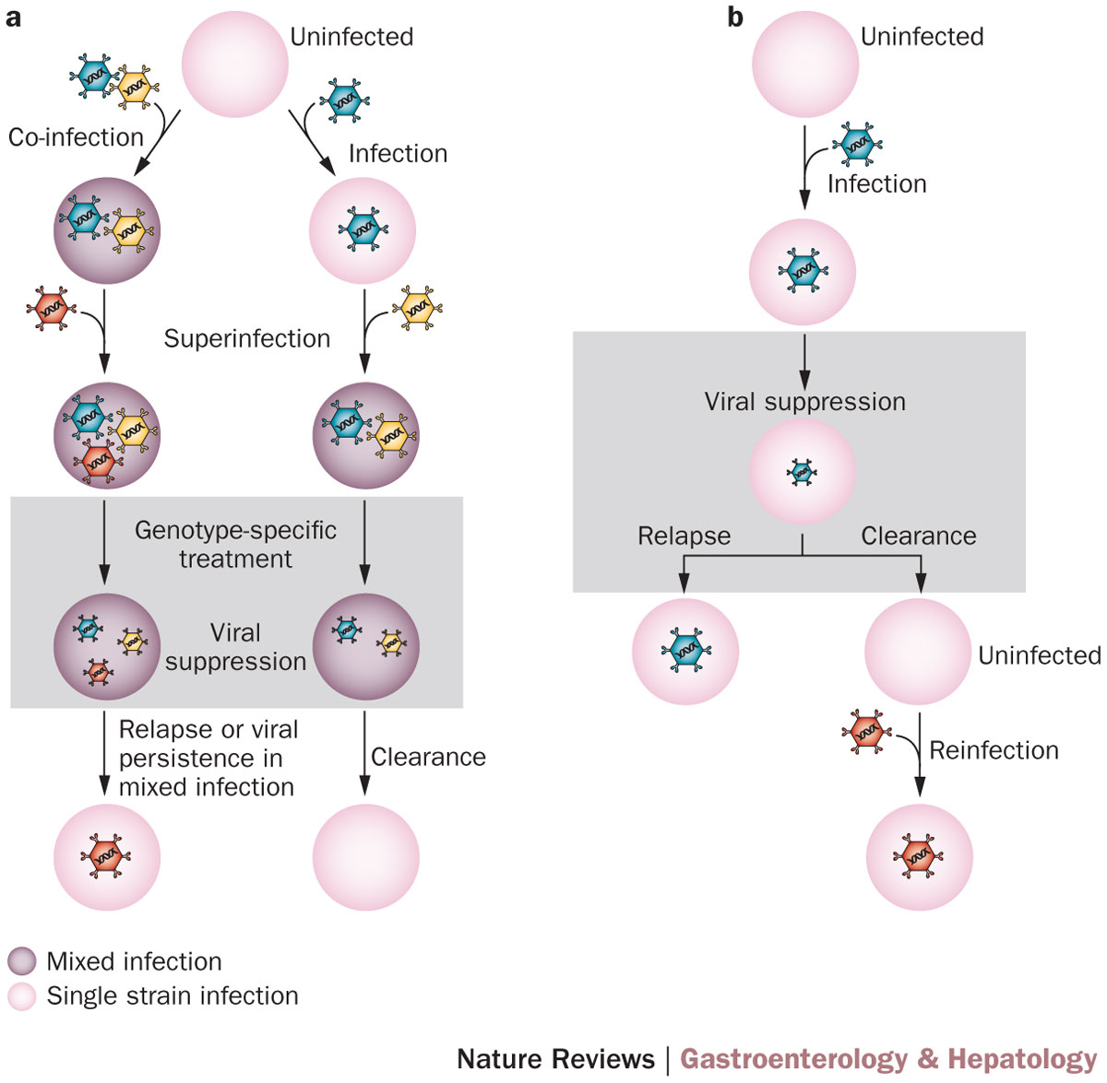
Mixed infection, superinfection or reinfection
Cunningham, E. B. et al. (2015) Mixed HCV infection and reinfection in people who inject drugs—impact on therapy
Nat. Rev. Gastroenterol. Hepatol. doi:10.1038/nrgastro.2015.36

Slide 24
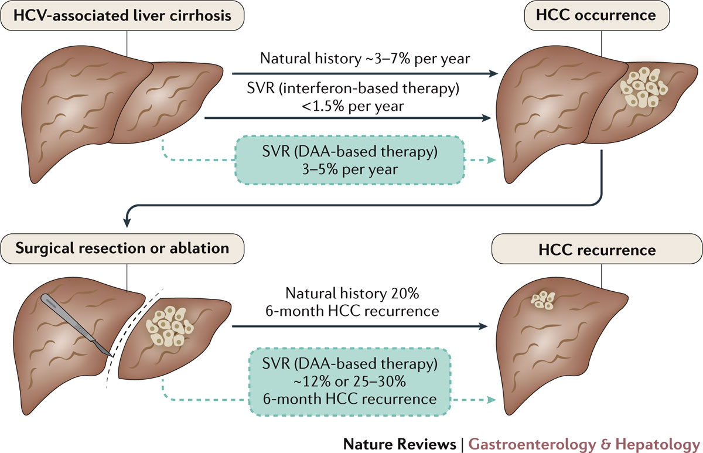
The incidence of HCC post DAA treatment
Llovet, J. M. & Villanueva, A. (2016) Effect of HCV clearance with direct‑acting antiviral agents on HCC
Nat. Rev. Gastroenterol. Hepatol. doi:10.1038/nrgastro.2016.140

Slide 25
The end of history?
Manns, M. P. et al. (2017) Hepatitis C virus infection
Nat. Rev. Dis. Primers doi:10.1038/nrdp.2017.6

